Slide 1


Fundamentals
Of Web
Development

Slide 2

Topics to be covered in
Web browser
Internet

Slide 3

Web Browsers

Slide 4

Web Browsers
Introduction to web browsers

Slide 5

Web Browsers
Features of web browsers

Slide 6
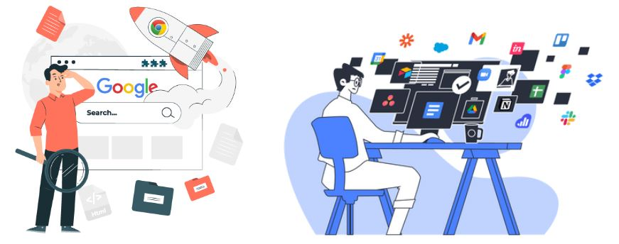
Browser Engine

Slide 7
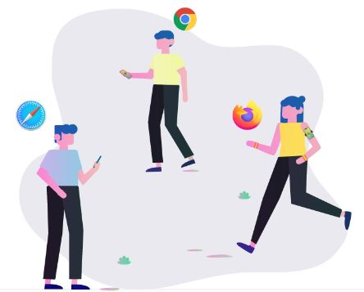
Browser Engine
Introduction to Browser Engine

Slide 8

Browser Engine
Responsibilities of the browser engine

Slide 9
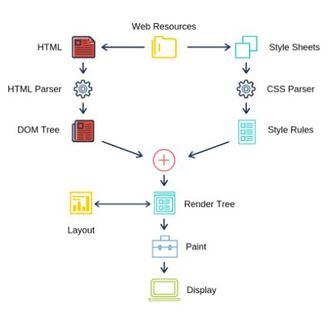
Browser Engine
How does a browser display a website from a url?

Slide 10

Browser Engine
Common browser compatibility issues

Slide 11

Internet

Slide 12

Internet
What is Internet ?

Slide 13

Internet
Important Terminologies.

Slide 14
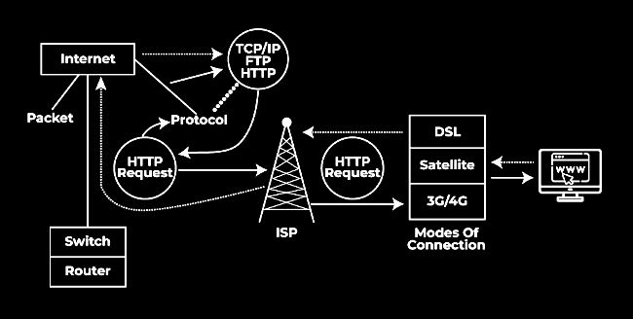
Internet
How does internet works?

Slide 15
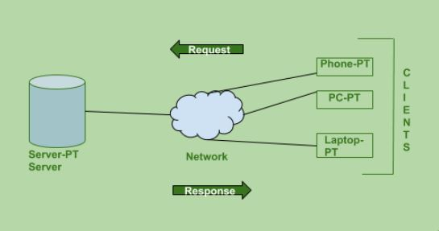
Client and Server

Slide 16
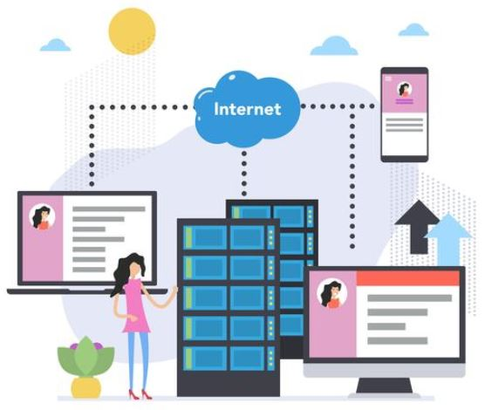
Client and Server
Introduction to Client.

Slide 17

Client and Server
Introduction to Server.

Slide 18
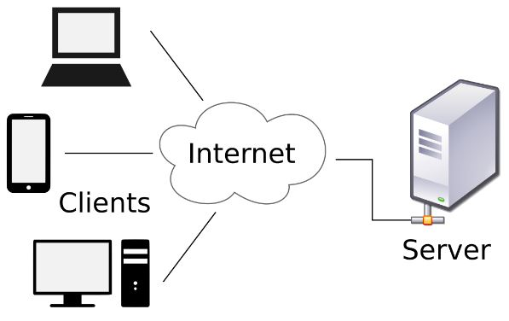
Client and Server
How do Clients and Servers Work Together?

Slide 19

THANK YOU

